Slide 1


Professional Exploration Project Project Report
Optimization of Telemarketing Process by Customer Data Analysis at Insurance Company.
Kevin Nugraha Salim
Professional Preparation Program by Tanoto Foundation Indonesia 2021
November 2021

Slide 2


Outline:
Introduction & Problem Statement
Project Objectivities & Desired KPI
Methodology
Data Overview
Data Splitting and Preparation
Project Results
Conclusion

Slide 3



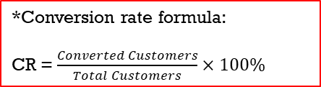
Introduction & Problem Statement:
Currently in one of the business units from my insurance company, is conducting a sales scheme (campaign) of an insurance product to 45,211 customers with a free premium scheme for first 3 months, then they will be offered to switch to paid scheme in the 4th month or later. Customers who do not want to switch will be offered again later.
The method used in this campaign is conventional telemarketing (referred as BAU/Business As Usual), which only has a conversion rate of 11.7% (baseline level).
Possible Outcomes :
*Conversion rate formula:
CR = $\frac{Converted Customers}{Total Customers}×100\%$
Current Customers:
45,211
List of Data:
Age
Job
Marital Status
……
……
Convert
Converted Customers
5,289
Offered by
BAU Method
Conversion Rate* :
11.70%
All customers are offered with insurance products for free (free trial) for the first 3 months. Then afterwards offered again to switch to paid scheme for the 4th month or later.
Customers who want to switch are called ‘Converted’ customers.
Non-converted Customers
39,922
Problem Statement:
How Machine Learning will improve this?

Slide 4


Project Objectivities & Desired KPI:
Predict and gain insights of converted customers.
Increase the efficiency of telemarketing campaigns by increasing the conversion rate up to 40% aided by the machine learning model.

Slide 5
Methodology:
Customer Database:
45,211 Customers
Machine Learning Model Development
List of Important Variables
Training Dataset
(70% or 31,647)
Exploratory Data Analysis (EDA) & Cleaning Impurities
Splitting Train and Validation Data
with ratio 70 : 30
Important Variable Performance Testing
Validation Dataset
(30% or 13,564)
Results of Insights
Using Validation Data for testing the important variable.

Slide 6
Data Overview:
List of data features:
Details | Value
Total Data | 45,211
Total Converted Customers | 5,289
Conversion rate (Baseline) | 11.70%
Variabel | Explanation & Data Examples
Reference ID | Customer’s Policy Number [Unique ID].
Age | 30, 26, 45, ….
Age Class | Below 25; 25-30; 31-35; 36-40; 41-45; 46-50; Above 50
Job | Employee; Entrepreneur; Student; Unemployed and Housemaid/Wife
Marital Status | Single; Married and Divorced
Education | Below High School; High School dan University
Own CC | Having CC or not? (Yes/No)
House Type | Private House and Rent.
Days Difference from Last Previous Call | 0, 1, 2, 3, ….
Number of Prev. Attempts | 0, 1, 2, 3, 4, 5, ….
Days Difference from Last Previous Call Class | 0-5 Days; 6-10 Days; More than 10 Days
Number of Prev. Attempts Class | 0-2x; 3-5x; More than 5x
: Selected variable for build predictive model.
: Added/Self-made variable.

Slide 7
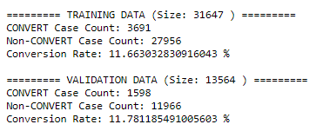

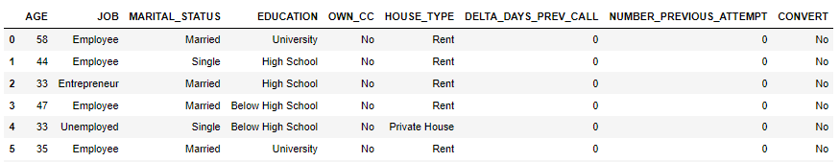
Data Splitting and Preparations:
The whole data (~45k) will be divided into 2 dataset (training and testing) with ratio of 7 (train) : 3 (test).
Training Dataset (~31k) will be used for build predictive machine learning model, with used algorithms is Random Forest Classifier.
Validation Dataset (~13k) will be used for testing the performance of model.

Slide 8



Project Results
Variable Importance of each variables
Validation Results
Decision Chart (additional)

Slide 9
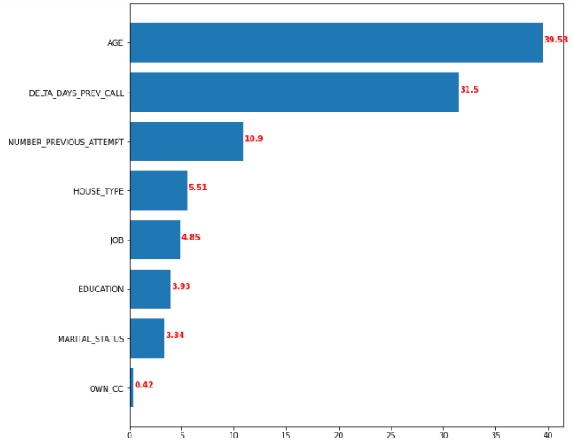
Variable importance of each variables:
Top 85% Variables Analysis:
Top 85% Variables
Therefore, we can mark and highlight the best segmentation from each top 85% important variables by looking the highest conversion rate.

Slide 10
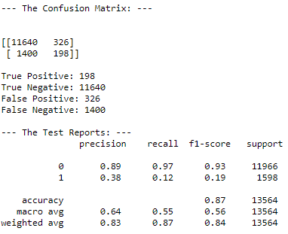
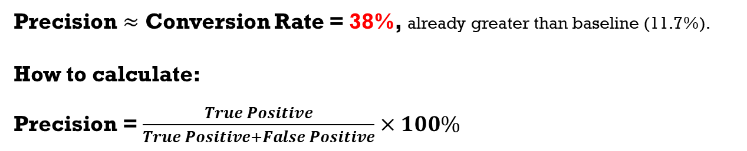
Validation results (1):
Precision $≈$ Conversion Rate = 38%, already greater than baseline (11.7%).
How to calculate:
Precision = $\frac{True Positive}{True Positive+False Positive}×100\%$
Note:
‘Precision’ in here can be referred as conversion rate, because telemarketing operation usually aim highest actual true positive (TP) among all data with score above the cutoff.
The cutoff score (w/ scale 0-100) which used in this case is 50, meaning that data with score above 50 will be predicted as true.

Slide 11
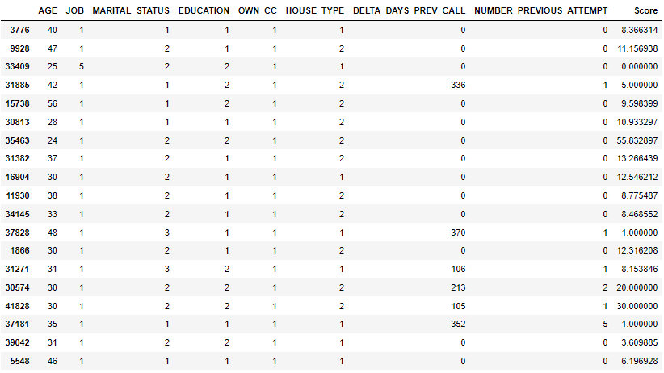
Validation Results (2):
From 13,564 of validation data, there are 524 data which has score 50 and above.
Therefore, this process can be interpreted as to find top 524 customers that hopefully 198 of them will actually buy the product, (or with a conversion rate of 38%).

Slide 12
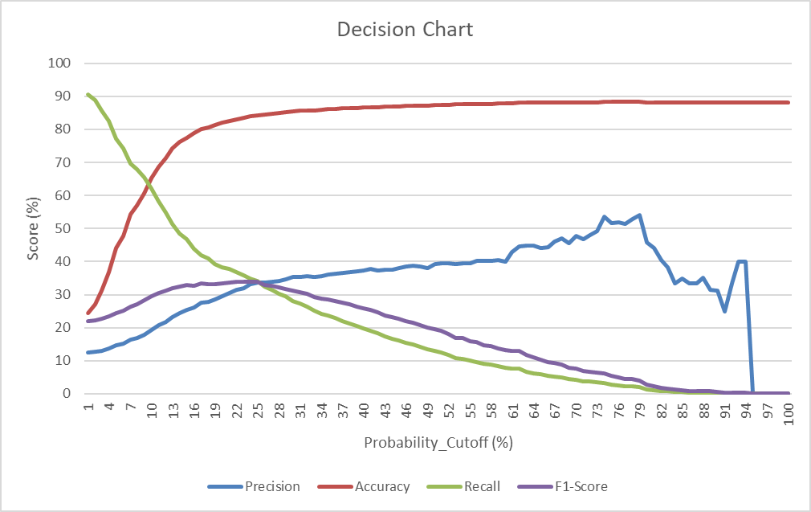
Decision CHART:
Ideally, we should pick the cutoff score at this point (so the ideal cutoff score should be 25), because we tend to aim model with highest F1-Score as possible. However, the purpose of this project to maximize the conversion rate, which is the ‘precision’ of the model.
The picked cutoff score in this example is 50, the main rule to choosing is to seek balance between precision and F1-score.

Slide 13
Conclusions:
Customers who have the potential to convert successfully are those who have the following important characteristics below:
Customers with age 25 or below.
Offered again after 10 days after the previous offer.
Have been offered about 3-5 attempts before.
Own a private house.
The simulated results of the prediction model successfully increase the conversion rate from BAU methods (from 11.7% to 38%).
In addition, it can expect 198 out of the top 524 customers from validation data will buy the product (converted).

Slide 14
THANK YOU
For details, reach me at my email:
kevinnugraha106@gmail.com

